Slide 1


ELBECHNA Zakaria
16/09/2022
https://github.com/ZakariaElbe1

Slide 2

Outline
Executive Summary Slide : 2
Introduction Slide : 2
Methodology Slide : 5
Results Slide : 17
Conclusion Slide : 45
Appendix Slide : 46

Slide 3
Executive Summary
Summary of methodologies
Collecting data from public SpaceX API and SpaceX Wikipedia page by web scrapping at first stage;
Transforming a Categorical variable to be a dependent variable to classify the success and failure landing;
Exploratory data analysis using SQL, pandas, visualization, folium maps, and dashboard.
Gathering relevant columns to be used as features. Changed all categorical variables to binary using one hot encoding.
Standardizing data and using GridSearchCV to find best parameters for machine learning models. Visualize accuracy score of all models.
Summary of all results
- Using four machine learning algorithms for classification: Logistic Regression, Support Vector Machine, Decision Tree Classifier, and K Nearest Neighbors;
Using the best parameters founded by GridSearshCV ,All models produced similar results with accuracy rate equal to 83.33% with similar precision, recall and F1_score.
All models over predicted successful landings. More data is needed for better model determination and accuracy.

Slide 4
Introduction
Background
Commercial Space Age is Here
Space X has best pricing ($62 million vs. $165 million USD)
Largely due to ability to recover part of rocket (Stage 1)
Space Y wants to compete with Space X
Problem:
Space Y want to predict successful Stage 1 recovery;
=>For that , the company ask us to build a machine Learning classification to predict successful stage 1 recovery
Space X
Space Y
VS

Slide 5

Section 1

Slide 6
Methodology
Executive Summary
Data collection methodology:
Combining data from SpaceX public API and SpaceX Wikipedia page web scrapping
Perform data wrangling
Classifying landings as success and failure landing
Perform exploratory data analysis (EDA) using visualization and SQL
Perform interactive visual analytics using Folium and Plotly Dash
Perform predictive analysis using classification models
Tuning models using GridSearchCV to find the best parameters for every model chosen

Slide 7
Data Collection
Data collection process involved a combination of API requests from Space X public API and web scraping data from a table in Space X’s Wikipedia entry.
The features extracted using the methods below are:
Data Columns founded by Space X API :
FlightNumber, Date, BoosterVersion, PayloadMass, Orbit, LaunchSite, Outcome, Flights, GridFins,
Reused, Legs, LandingPad, Block, ReusedCount, Serial, Longitude, Latitude
Data Columns founded by web scraping the Wikipedia Sapce X page:
Flight No., Launch site, Payload, PayloadMass, Orbit, Customer, Launch outcome, Version Booster, Booster landing, Date, Time

Slide 8
Data Collection – Spacex API
.JSON file + Lists(Launch Site, Booster Version, Payload Data)
Request (Space X APIs)
Json_normalize to DataFrame data from JSON
Data Collection – Spacex API GitHub url :
https://github.com/ZakariaElbe1/IBM-Capstone-Project-DSC/blob/master/data%20collection%20using%20APIs%20and%20Webscraping/1-spacex-data-collection-api.ipynb
Filter data to only include Falcon 9 launches
Imputate missing PayloadMass values with mean
Dictionary relevant data
Cast dictionary to a DataFrame

Slide 9
Data Collection – Web Scraping
Requests get Wikipedia page html
BeautifulSoup from bs4
Html5lib parser
Find launchs info html table , headers,…
Data Collection – Web Scraping GitHub url :
https://github.com/ZakariaElbe1/IBM-Capstone-Project-DSC/blob/master/data%20collection%20using%20APIs%20and%20Webscraping/1-webscraping.ipynb
Extract dictionary’s data by iteration over every rable row
Collecting info into a dictionnary where keys will be the columns names
Dictionnary to pandas DataFrame

Slide 10
Data Wrangling
Data transformation : transforming landing outcomes feature from categorical to numeric data; successful = 1 and failure = 0.
New label column ‘class’ was created (it’s our dependent variable or target) with a value of 1 if ‘Mission Outcome’ is True and 0 otherwise. Value Mapping:
- True ASDS, True RTLS, & True Ocean – set to value 1
- None None, False ASDS, None ASDS, False Ocean, False RTLS – set to value 0
Data Wrangling GitHub url :
https://github.com/ZakariaElbe1/IBM-Capstone-Project-DSC/blob/master/EDA%20of%20Falcon9%20data/2-spacex-Data%20wrangling.ipynb

Slide 11
EDA with Data Visualization
Exploratory Data Analysis performed on variables Flight Number, Payload Mass, Launch Site, Orbit, Class
and Year. The main goal from using this process is to define the relationship between features.
Plots Used:
Flight Number vs. Payload Mass,
Flight Number vs. Launch Site,
Payload Mass vs. Launch Site,
Orbit vs. Success Rate,
Flight Number vs. Orbit,
Payload vs Orbit
Success Yearly Trend
Scatter plots, line charts, and bar plots were used to compare relationships between variables to
decide if a relationship exists so that they could be used in training the machine learning model
EDA with data visualization GitHub url :
https://github.com/ZakariaElbe1/IBM-Capstone-Project-DSC/blob/master/EDA%20of%20Falcon9%20data/2-eda-dataviz.ipynb

Slide 12
EDA with SQL
Using SQL for Exploratory Data Analysis , we were able to:
Understand the Spacex DataSet
Load the dataset into the corresponding table in a Db2 database
Execute SQL queries for better understanding our data, such as : informations between features (launch site names, mission outcomes, various pay load sizes of customers and booster versions, and landing outcomes)
EDA with SQL Github url :
https://github.com/ZakariaElbe1/IBM-Capstone-Project-DSC/blob/master/EDA%20of%20Falcon9%20data/2-eda-sql-coursera.ipynb

Slide 13
Build an Interactive Map with Folium
The launch success rate depend on the location and proximities of a launch site, for that , we used an interactive map to mark launch sites on map with success rate for each site. For that many objects was created and added to a map using the folium library, such as :
Markers : used to mark a specific site or pinning it geographically using geographic coordinates, it’s a way to interpret coordinates to visualize closeness between launch sites
Circles : used to mark a site area as circle by giving a radius and color where the circle’s center is a marker already created;
Markers cluster : used for clustering markers on each site by grouping its by a feature, in our situation ,success/failed launch was the feature to split markers by
Line : shows connection between site and a specific chosen location, but before that, we must calculate distance between the two points
Interactive map with Folium Github url :
https://github.com/ZakariaElbe1/IBM-Capstone-Project-DSC/blob/master/Launch%20sites%20locations%20and%20Dashboard%20for%20analysis/lab_jupyter_launch_site_location.ipynb

Slide 14
Build a Dashboard with Plotly Dash
Dashboard includes a pie chart and a scatter plot by launch site, for creating our dashboard , we used “dash” library
Pie chart created using “plotly” lib with express method, it can be selected to show distribution of successful landings across all launch sites and can be selected to show individual launch site success rates.
Scatter plot created using “plotly” lib with express method,it takes two inputs: All sites or individual site and payload mass on a slider between 0 and 10000 kg.
The pie chart is used to visualize launch site success rate.
The scatter plot can help us see how success varies across launch sites, payload mass, and booster version category.
My dashboard code - Github url :
https://github.com/ZakariaElbe1/IBM-Capstone-Project-DSC/blob/master/Launch%20sites%20locations%20and%20Dashboard%20for%20analysis/my%20dashbord%20for%20the%20capstone%20ibm%20ds%20project.ipynb

Slide 15
Predictive Analysis (Classification)
Split dependent variable ‘target’ and features
Score models on
Confusion Matrix
split test set
for all models
Features scaling
With StandardScaler
And fit and transform our features
Use GridSearchCV
Classification report to better evaluate our classifiers
on LogReg, SVM,
Decision Tree, and
KNN models
Classification GitHub url :
https://github.com/ZakariaElbe1/IBM-Capstone-Project-DSC/blob/master/machine%20learning%20prediction/SpaceX_Machine%20Learning%20Prediction_Part_5.ipynb
Train_test_split
GridSearchCV
data
(cv=10) to find optimal parameters

Slide 16
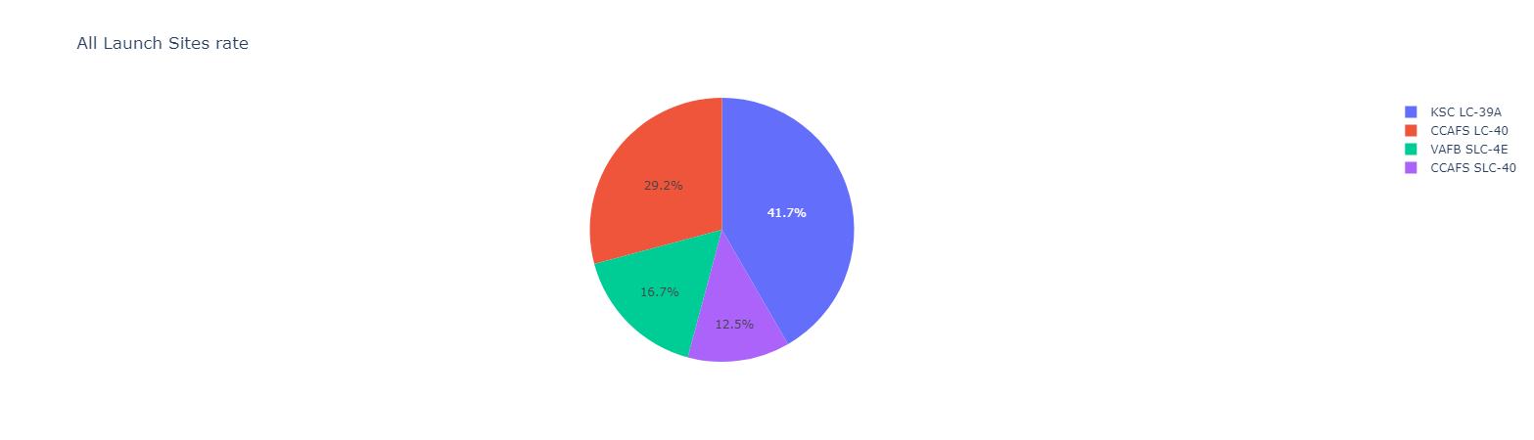
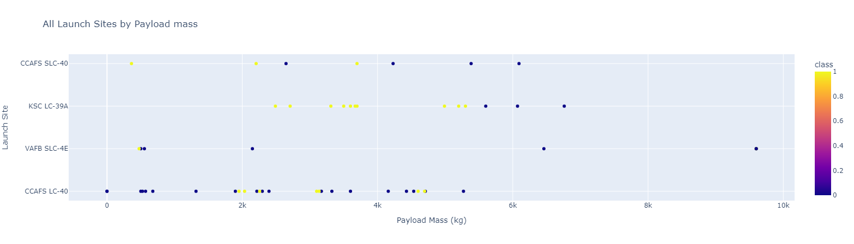
Results
SpaceX Launch Records Dashboard
Pie Chart for All sites Scatter plot launch sites vs Payload mass
The graphs below belongs to our created dashbord, it shows the success rate for each launch site and the mass of the payload launched from each site.
EDA : Using The EDA process, we did some data manupilation ,engineering ,transformation and visualisation. We transormed data from categorical to numerical using one hot enconding for example , we visualize features to understand relationship between its.
Classification : Our models have the same producted accuracy with a rate of 83,34%

Slide 17

Visualization

Slide 18
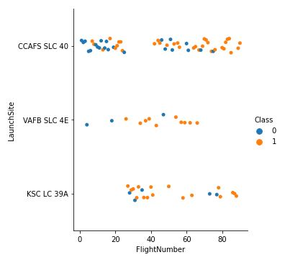
Flight Number vs. Launch Site
Flight Number vs. Launch Site
Graph explanations :
Graph shows that the CCAFS has more volume of flights, it appears to be the main launch site;
After the 20th flight the success rate increase for every lauch sites, and KSC site appears to be start launching;
The VAFB has the best success rate against small volume of flights
Failure Success

Slide 19
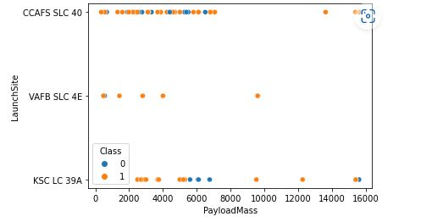
Payload vs. Launch Site
Scatter plot of Payload vs. Launch Site
Graph explanations :
The majority of payloads launched from each site have a masse under 8000kg
The payloads with a mass bigger than 8000 kg appears to have a good success rate
Failure Success

Slide 20
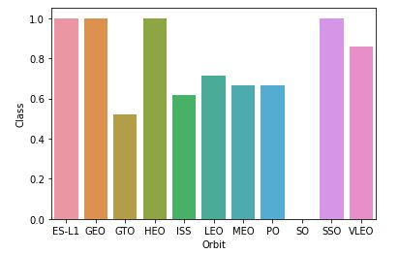
Success Rate vs. Orbit Type
Bar chart for the success rate of each orbit type
Graph explanations (sample sizes in parenthesis) :
ES-L1 (1), GEO (1), HEO (1) have 100% success rate
SSO (5) has 100% success rate
VLEO (14) has decent success rate and attempts
SO (1) has 0% success rate
GTO (27) has the around 50% success rate but largest sample

Slide 21
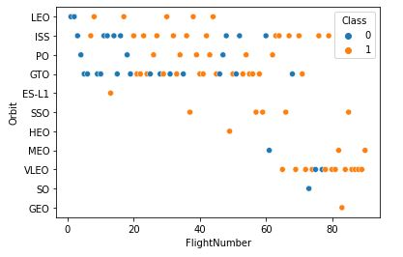
Flight Number vs. Orbit Type
Scatter point of Flight number vs. Orbit type
Graph explanations :
After 50 flight, the success rate increase on different Orbit type other than LEO
ISS and GTO have big number of flights comparing to other Orbit type
Flights on VLEO Orbit starts from the 60th flight
Flights on PO stopped in the 60th and stopped on 45th on LEO Orbit
in the LEO orbit the Success appears related to the number of flights; on the other hand, there seems to be no relationship between flight number when in GTO orbit
Failure Success

Slide 22
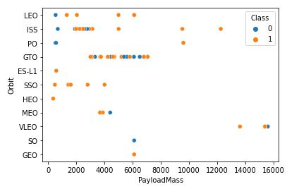
Payload vs. Orbit Type
Scatter point of payload vs. orbit type
Graph explanations :
With heavy payloads the successful landing or positive landing rate are more for Polar,LEO and ISS.
However for GTO we cannot distinguish this well as both positive landing rate and negative landing(unsuccessful mission) are both there here
Failure Success

Slide 23
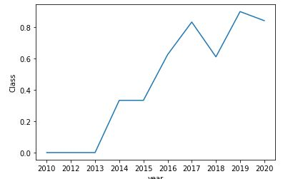
Launch Success Yearly Trend
Line chart of yearly average success rate
Graph explanations :
the sucess rate since 2013 kept increasing till 2020 with a breakdown in 2018
The biggest success rate was in 2019

Slide 24
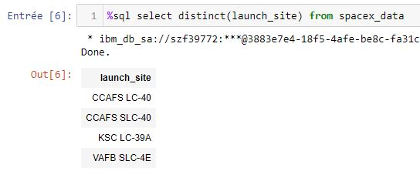
All Launch Site Names
Query of names of the unique launch sites from database
CCAFS SLC-40 and CCAFSSLC-40 likely all represent the same
launch site with data entry errors.

Slide 25
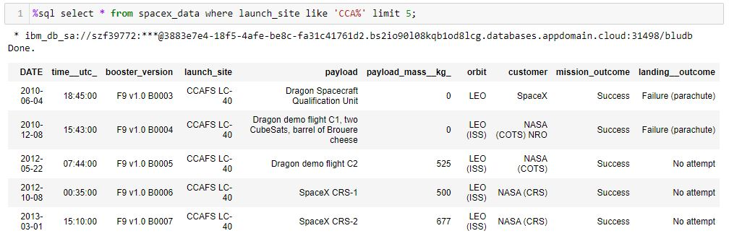
Launch Site Names Begin with 'CCA'
Query of 5 records where launch sites begin with `CCA`
All the 5 records shows a success mission outcome, from CCA launch site

Slide 26
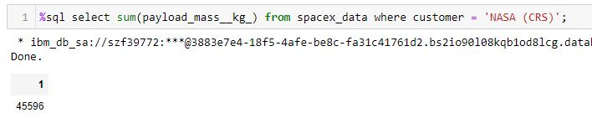
Total Payload Mass
Query of total payload carried by boosters from NASA
This query sums the total payload mass in kg where NASA was the customer.

Slide 27
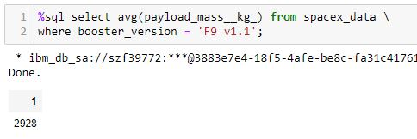
Average Payload Mass by F9 v1.1
Query of average payload mass carried by booster version F9 v1.1
The payload mass for the booster version F9 v1.1 seems to have a light mass comparing to others booster versions

Slide 28
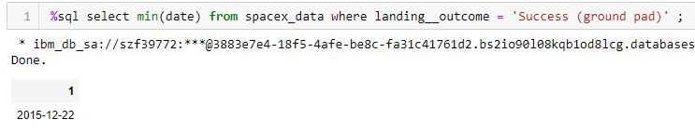
First Successful Ground Landing Date
Query of the dates of the first successful landing outcome on ground pad
The first success ground pad landing wasn’t until the end of the year 2015

Slide 29
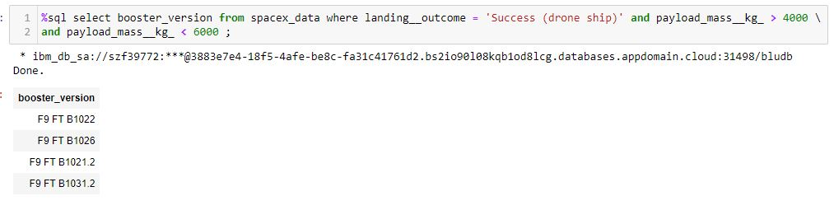
Successful Drone Ship Landing with Payload between 4000 and 6000
Query of List the names of boosters which have successfully landed on drone ship and had payload mass greater than 4000 but less than 6000
The query shows the four success boosters landed on drone ship with a payload mass between 4000 and 6000 kg excluded

Slide 30
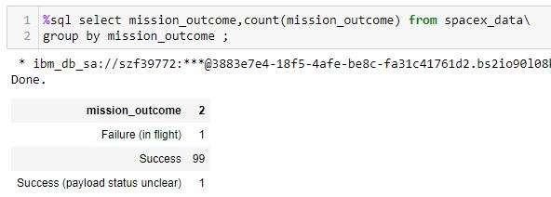
Total Number of Successful and Failure Mission Outcomes
Query of the total number of successful and failure mission outcomes
The space X rate of success mission outcome is 98.02%

Slide 31
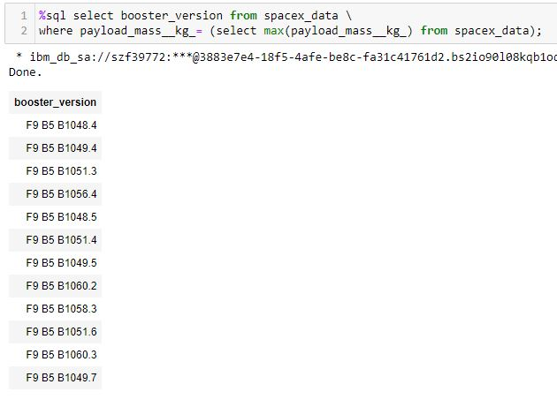
Boosters Carried Maximum Payload
Query of List the names of the booster which have carried the maximum payload mass
The booster version F9 B5 B10** appears to be the heavy ones, it shows that is a correlation between payload mass and the booster version

Slide 32
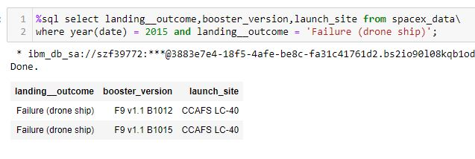
2015 Launch Records
Query of List the failed landing outcomes in drone ship, their booster versions, and launch site names for in year 2015
The query result shows that there is a two failed landing on drone ship both launched from the same site which is CCAFS site

Slide 33
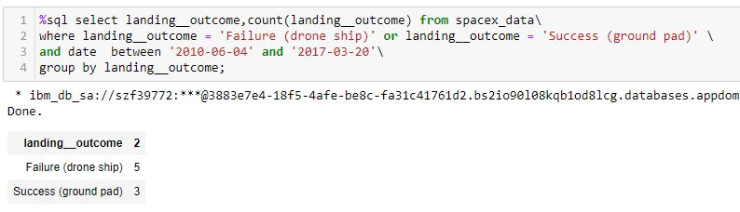
Rank Landing Outcomes Between 2010-06-04 and 2017-03-20
Query of Rank the count of landing outcomes (such as Failure (drone ship) or Success (ground pad)) between the date 2010-06-04 and 2017-03-20, in descending order
The query result shows a count of 8 of failure drone ship landing (5) and success ground pad landing(3) between the date 2010-06-04 and 2017-03-20

Slide 34

Section 3

Slide 35
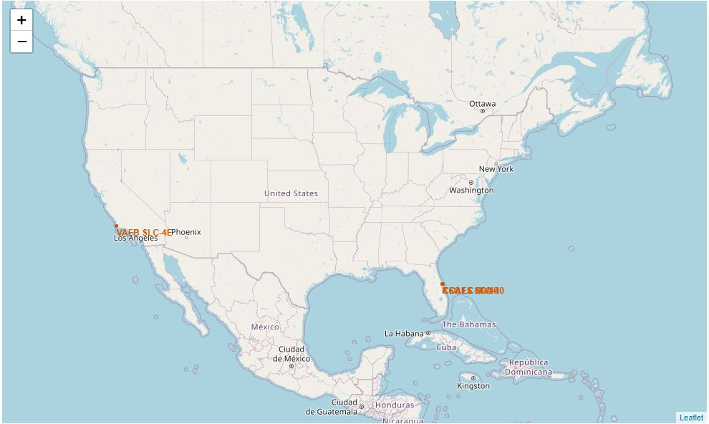
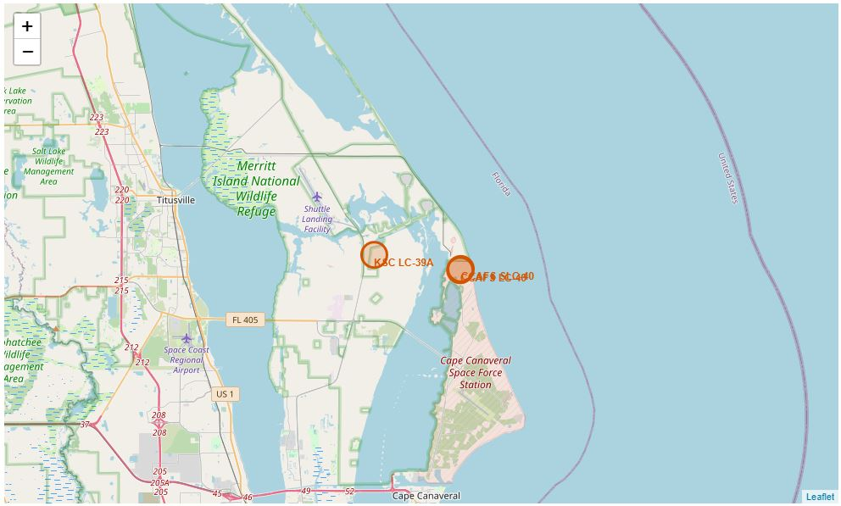
All launch sites locations on map
The right map produced shows that all sites are near to the coast;
The left map shows launch sites close to Florida coast
Launch sites are placed on north of the equatorial line

Slide 36
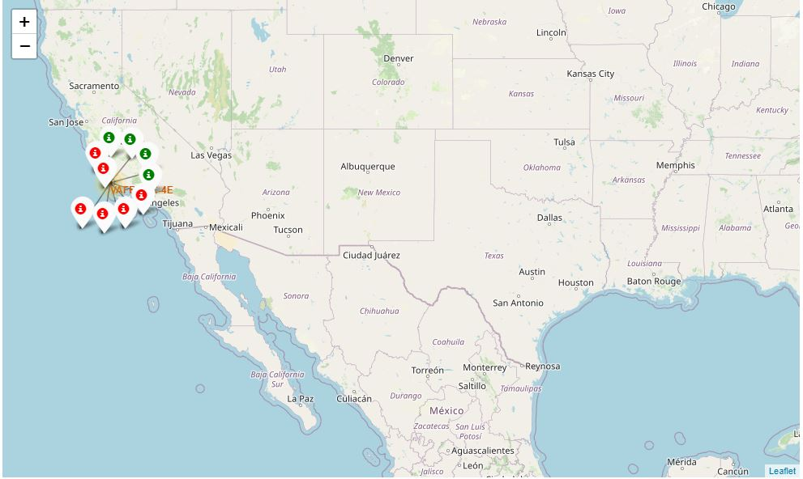
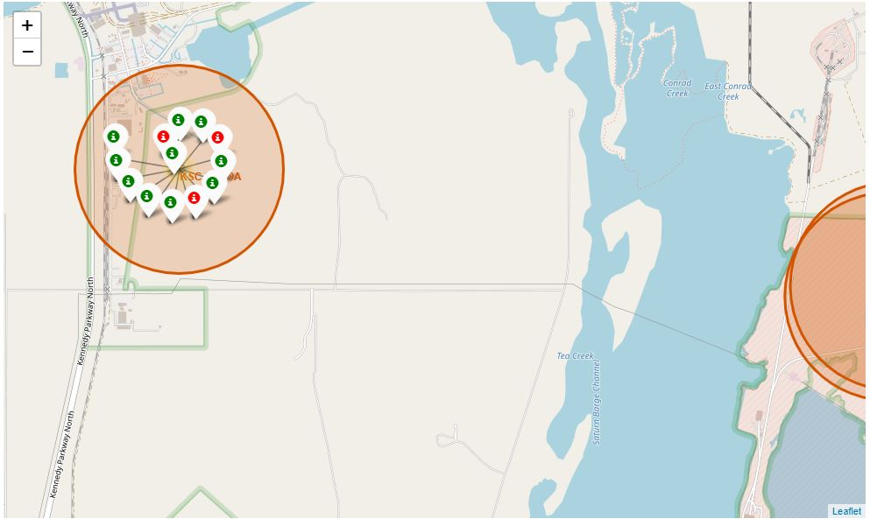
Labeled launch sites by success/failed launches
Failure Success
In this example on the left VAFB SLC-4E shows 4 successful landings and 6 failed landings using markers cluster by folium
On the right KSC LC-39A shows 10 successful landings and 3 failed landings,
We can conclude that the launch sites on the east have more records and best success landing rate

Slide 37



Locations proximities
Using KSC LC-39A as an example, launch sites are very close to railways for large part and supply transportation. Launch sites are close to highways for human and supply transport. Launch sites are also close to coasts and relatively far from cities so that launch failures can land in the sea to avoid rockets falling on densely populated areas.

Slide 38

Section 4

Slide 39
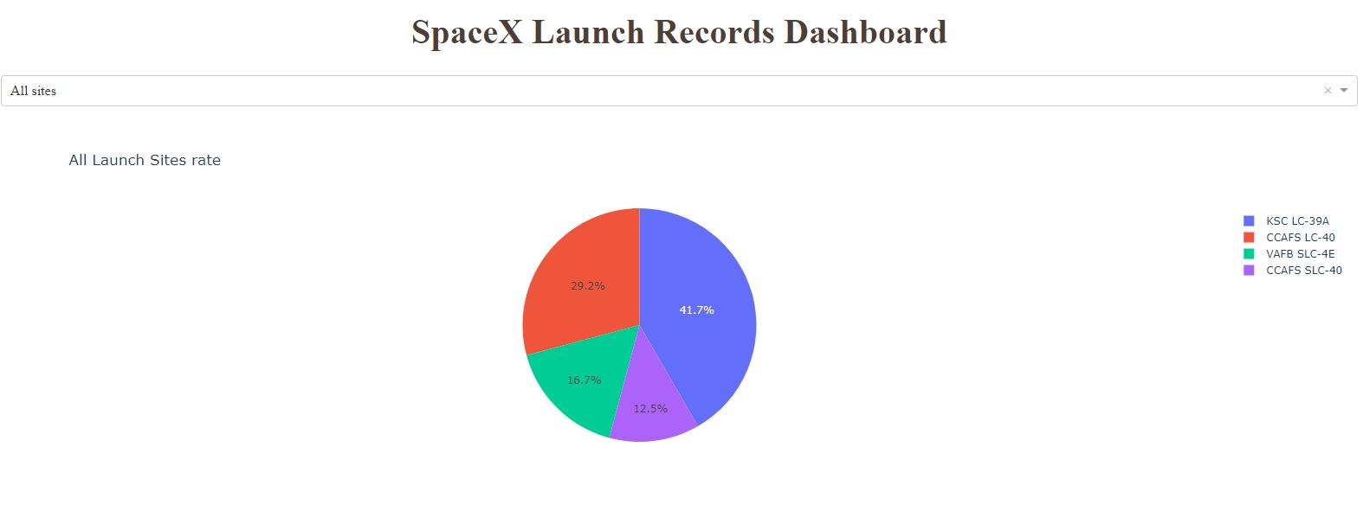
Dashboard : Success rate for all sites
The piechart from our dashboard shows that KSC LC-39A site have the best landing success rate, it confirms the result of labeled map locations on the previous section where we concluded that the launch sites located on the east coast have a good success rate comparing to VAFB site located close to the west coast

Slide 40
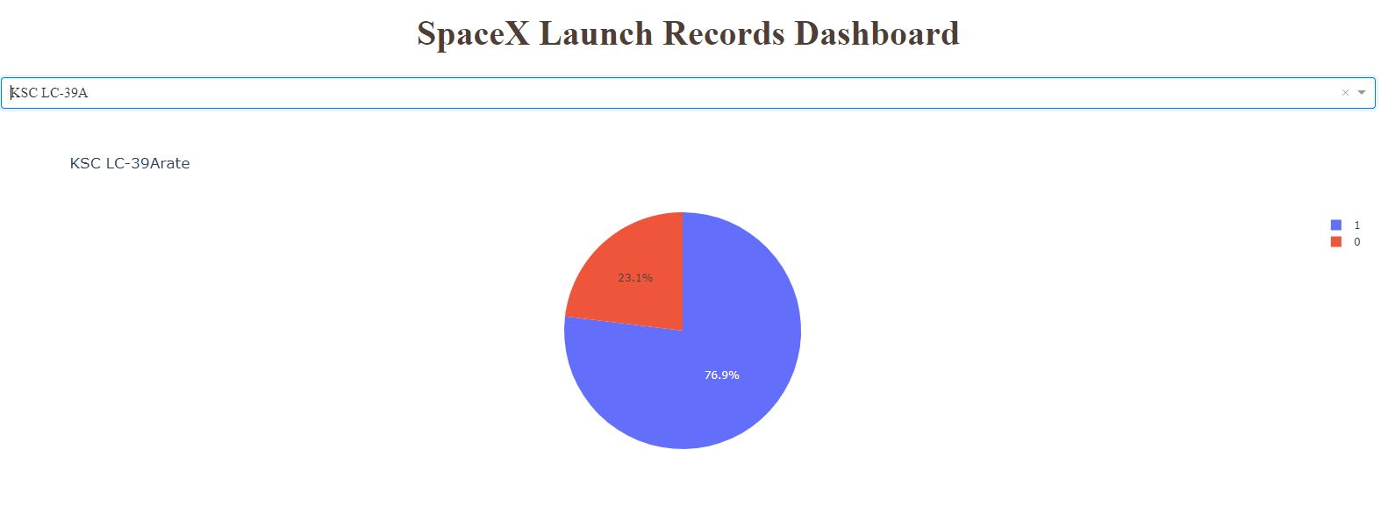
Dashboard: Success ratio of KSC Site
Failure Success
The pie chart of the launch site with the best success landing ratio with more than 75% success landing

Slide 41

Payload Mass vs. Success vs. Booster Version Category
Plotly dashboard has a Payload range selector. However, this is set from 0-10000 instead of the max Payload of 15600. Class indicates 1 for successful landing and 0 for failure. Scatter plot also accounts for booster version category in color and number of launches in point size. In this particular range of 0-6000, interestingly there are two failed landings with payloads of zero kg.

Slide 42


Slide 43
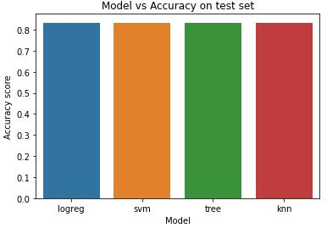
Classification Accuracy
All models had the same accuracy on the test set at 83.33% accuracy. We could explain that by the small test size at only sample size of 18.
It should be noted that the Decision tree model with more than one run produced multiple accuracy scores, it depends on quality of split that the model did.
We likely need more data to determine the best model.

Slide 44
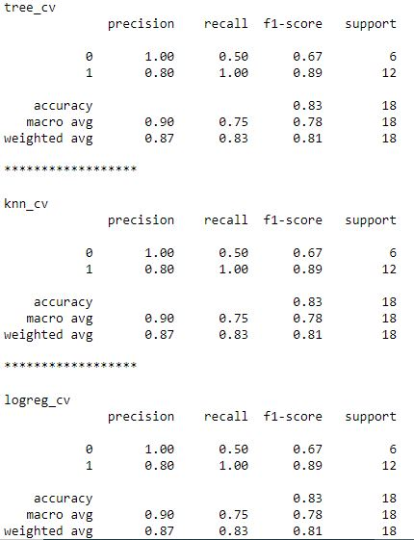
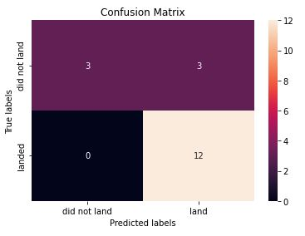
Confusion Matrix
Since the four models had the same accuracy, precision, recall and F1_score on the test set , we displayed only one confusion matrix
The 4 models had missclassify 3 failed landing as a success landings and they classified the rest successfuly

Slide 45
Conclusions
Our task: to develop a machine learning model for Space Y who wants to bid against SpaceX
The goal of model is to predict when Stage 1 will successfully land to save ~$100 million USD
Used data from a public SpaceX API and web scraping SpaceX Wikipedia page
Created data labels and stored data into a DB2 SQL database
Created a dashboard for visualization
We created a machine learning model with an accuracy of 83%
SpaceY can use this model to predict with relatively high accuracy whether a launch will have a successful Stage 1 landing before launch to determine whether the launch should be made or not
If possible more data should be collected to better determine the best machine learning model and improve accuracy

Slide 46
Appendix
All the files used in this presentation could be found by checking this Github url :
https://github.com/ZakariaElbe1/IBM-Capstone-Project-DSC/tree/master
And finally i want to thank all the instrutors, coursera platform and all of you guys

Slide 47


